Slide 1
Introduction to Deep Web Crawler/Scraping
Speaker: Yachao Lu
Zhao Gao

Slide 2
Outline
What is Web Crawler/Scraping
Surface Web vs Deep Web
Technique suggestions for surface web scraping
Deep Web challenges
Tech towards deep web scraping
Tools/ Libraries recommendation
Anti-Scraping Suggestions.
Notes:
I will share some interesting challenges I have

Slide 3
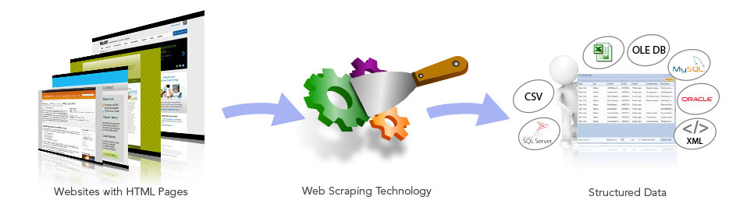
What is Web Crawler/Scraping
A web crawler (also known as a web spider or web robot) is a program or automated script which browses the World Wide Web in a methodical, automated manner.
A web scraping is the practice of gathering data through any means other than a program interacting with an API. And parse the data to extract needed information.
In practice, Web Crawler/Scraping encompasses a wide variety of programming technique challenges.
Notes:
I will share some interesting challenges I have

Slide 4
Typical Uses For Web Crawlers
The One You Use But Don’t Realize It — Search Engines
The One Developers Love — Scraping Data (Web Scraping) E.g. Price tracker application; Marketing Estimation over online database.
Notes:
When you search for something in Google, Google does not run a web crawler right then and there to find all the web pages containing your search keywords. Instead, Google has already run millions of web crawls and already scraped all the content, stored it, and scored it, so it can display search results instantly.

Slide 5

Surface Web & Deep Web
Surface Web
o Inter-linked web pages, ~167 tera bytes[1]
o Searchable through search engines
 Deep Web
o Dynamic contents, unlinked pages,
private web, contextual web, etc[3]
o ~91,850 tera bytes[1], much larger than
the surface web[2]
o Mostly out of reach by search engines
[1] SIMS, UC Berkeley, How much information? 2003
[2] Bright Planet, Deep Web FAQs, 2010, http://www.brightplanet.com/the-deep-web/
[3] https://en.wikipedia.org/wiki/Deep_web

Slide 6
Example for surface web
HTTP GET Request: https://nhmrc-stage.icfwebservices.com/library-search-results
Check The DIFFERENCE: https://nhmrc-stage.icfwebservices.com/library-search-results?search_api_aggregation_3=&search_api_aggregation_2=&search_api_views_fulltext=medical&items_per_page=10
https://nhmrc-stage.icfwebservices.com/library-search-results?search_api_aggregation_3=&search_api_aggregation_2=&search_api_views_fulltext=medical&items_per_page=10&page=1
P.S. Parameters for HTTP POST REQUEST can be checked via console

Slide 7
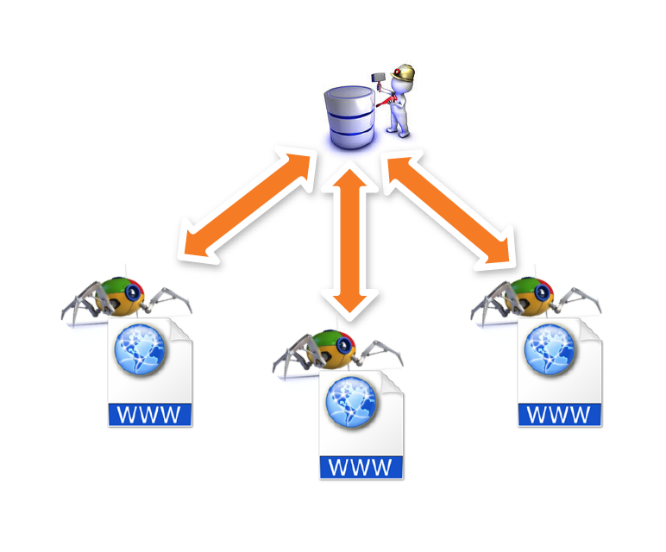
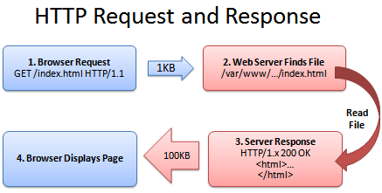
Surface web crawler: Compose a HTTP Request (GET/POST)
Notes:
Traditional Crawler: Download the resource and parse the html page

Slide 8
For surface web scraping
Do like most search engine do:
Analysis the HTTP GET/POST Request
Sent same request to server in your code and save the resource from the response
Analysis the DOM Structure of HTML
Extract the data and export to the format you want

Slide 9
Code example (a nodejs example)
var Crawler = require("crawler");
var c = new Crawler({........})
c.queue('https://nhmrc-stage.icfwebservices.com/library-search-results?search_api_aggregation_3=&search_api_aggregation_2=&search_api_views_fulltext=medical&items_per_page=10');
c.queue('https://nhmrc-stage.icfwebservices.com/library-search-results?search_api_aggregation_3=&search_api_aggregation_2=&search_api_views_fulltext=medical&items_per_page=10&page=1');

Slide 10

Demo

Slide 11
Example for deep web
(JS rendered, infinite scroll) https://www.pinterest.com/
So question here: Why traditional crawler cannot retrieve data?
We can understand deep web this way: DATA inside the database, which is not easily GET due to some limitations.
Notes:
JS cannot be rendered, not to see some human-reaction

Slide 12
For deep web challenges...
Two Main Categories
Complex Interface Problem (front-end)
Anti-Scraping Techs (back-end & front-end)

Slide 13
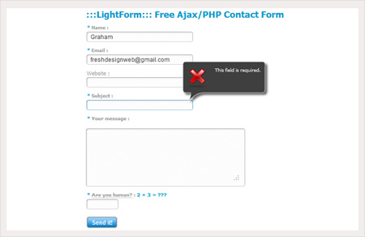
Complex Interface Problem
We cannot know how the query composed through URL or DOM (NOT Simple HTTP GET/POST method, e.g., ajax based websites or ajax-http request combined)
Front end trick codes

Slide 14

Examples for Front end tricks code
Redirect to log-in interface (Require registration & login):

Slide 15
Examples for Front end tricks code
2. Screw with the scraper: Insert fake, invisible honeypot data into your page
<div class="search-result" style="display:none"> <h3 class="search-result-title">This search result is here to prevent scraping</h3> <p class="search-result-excerpt">If you're a human and see this, please ignore it. If you're a scraper, please click the link below :-) Note that clicking the link below will block access to this site for 24 hours.</p> <a class"search-result-link" href="/scrapertrap/scrapertrap.php">I'm a scraper !</a> </div>
Notes:
A scraper written to get all the search results will pick this up, just like any of the other, real search results on the page, and visit the link, looking for the desired content. A real human will never even see it in the first place (due to it being hidden with CSS), and won't visit the link.

Slide 16
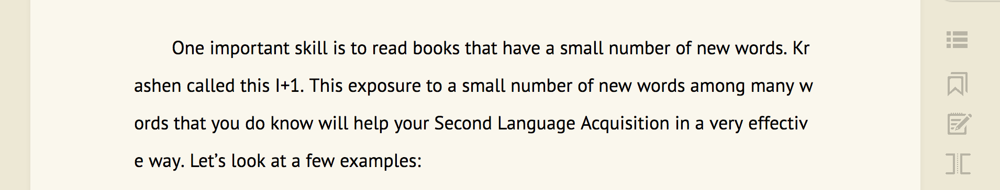
Examples for Front end tricks code
3. Serve your text content as an image
Notes:
You can render text into an image server-side, and serve that to be displayed, which will hinder simple scrapers extracting text.

Slide 17
Ant-Scraping Techs (back-end & front-end)
Most Common: Request Limitation. (e.g., mod_evasive, an Apache module); Some web hosting provide Scraper Protection, like CloudFlare, AWS.
Front-end JS based Web Scraper indicators (Front-end tricks)
Frequently change your HTML
Notes:
How fast users fill out forms, and where on a button they click;

Slide 18
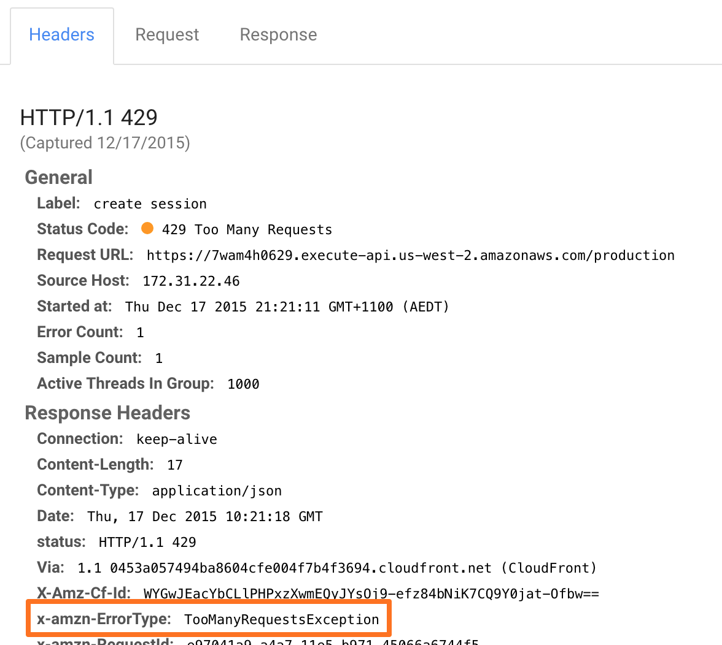
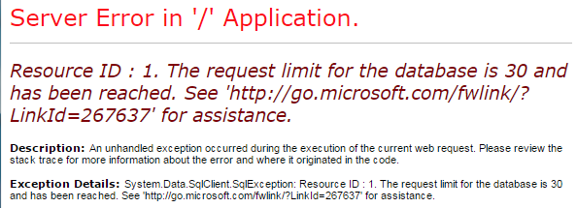
Examples: request limitation

Slide 19
Another Examples for Frequently change your HTML: leave old markups
<div class="the-real-search-result"> <h3 class="the-real-search-result-title">Stack Overflow has become the world's most popular programming Q & A website</h3> <p class="the-real-search-result-excerpt">The website Stack Overflow has now become the most popular programming Q & A website, with 10 million questions and many users, which...</p> <a class"the-real-search-result-link" href="/stories/stack-overflow-has-become-the-most-popular">Read more</a> </div> <div class="search-result" style="display:none"> <h3 class="search-result-title">Visit example.com now, for all the latest Stack Overflow related news !</h3> <p class="search-result-excerpt">EXAMPLE.COM IS SO AWESOME, VISIT NOW! (Real users of your site will never see this, only the scrapers will.)</p> <a class"search-result-link" href="http://example.com/">Visit Now !</a> </div>

Slide 20
Another example front-end trickers
You can gather a lot of information with JavaScript, such as screen size / resolution, timezone, installed fonts, etc; you can use this to identify users. Http headers and their order, especially User-Agent.
E.g., If navigator.userAgent is
"Mozilla" (Just that, nothing else. I've seen a few questions about scraping here, using that. A real browser will never use only that)
"Java 1.7.43_u43" (By default, Java's HttpUrlConnection uses something like this.)
"BIZCO EasyScraping Studio 2.0"

Slide 21
How to deal with deep web
Cutting-edge libraries save you time
Make your code run more like “human”
Screenscrapers/ browser automation

Slide 22
Tools/Library recommendation
Python: Scrapy
NodeJS: ScraperJS, NightmareJS
PHP: Goutte

Slide 23
Screenscrapers / browser automation
Selenium
PhantomJS
NightmareJS

Slide 24

Demo for nightmareJS

Slide 25

Questions?
Comments?

